Slide 1
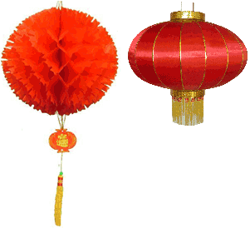
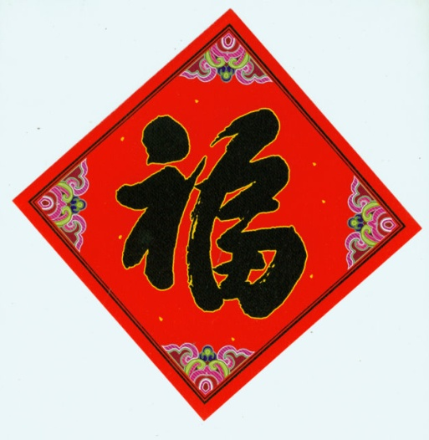
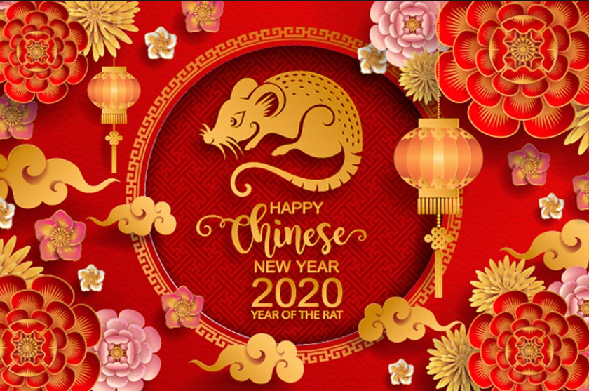
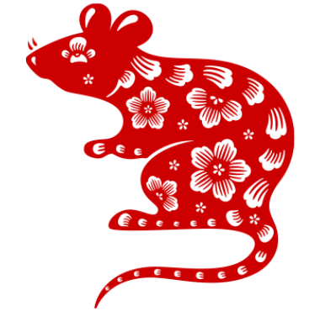
Celebrate Lunar New Year 2020– Year of the Rat

Slide 2
About Lunar New Year
Lunar New Year (also know as The Spring Festival) is an important traditional holiday celebrated on the first day of the year based on the Lunar calendar.
Lunar New Year is celebrated in countries and territories with significant Chinese populations, such as Mainland China, Hong Kong, Macau, Taiwan, Japan, Korea, Singapore, Thailand, Cambodia, Indonesia, Malaysia, Mauritius, Philippines, Vietnam, and also in Chinatowns elsewhere.
Information source:
http://www.chinesenewyears.info/

Slide 3
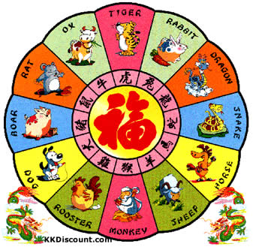
Lunar Zodiac
Used for 3000 years as a horoscope
Legend has it: Buddha summoned all animals for a meeting. Only 12 animals attended. Here is the arrival order.
Rat
Ox
Tiger
Rabbit
Dragon
Snake
Horse
Sheep
Monkey
Rooster/Cock
Dog
Boar
2020 is the year of the Rat 2021 will be the year of the Ox

Slide 4
Lunar New Year Greetings
新年快乐 (Sheen Nee-an Kwai Luh) Happy New Year
万事如意 (Wahn Shr Ru Ee) May all your wishes be fulfilled
恭喜发财 (Gong See Fa Tsai) Wishing you a prosperous year
岁岁平安 (Sway Sway Ping An) Peace be with you year after year

Slide 5
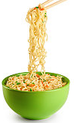
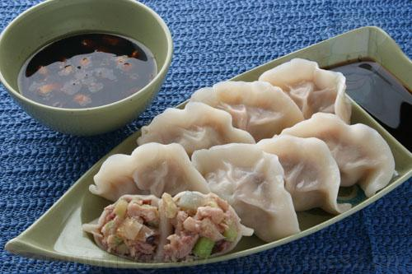
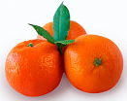
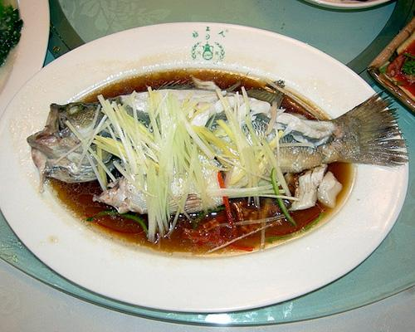
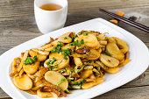
Lunar New Year Food Eat Food With Meanings
Dumpling
Dumpling, resembles gold nugget.
Whole Fish
Fish, in Chinese, sounds like “abundance,” which is why it is a good luck food. Also it is served with the head and tail intact to ensure a good year, from start to finish.
Noodles
represent longevity.
Clementine sounds like the words “lucky” and “prosperous”.
Sticky Rice Cake
sounds like the word “higher year” in Chinese.

Slide 6
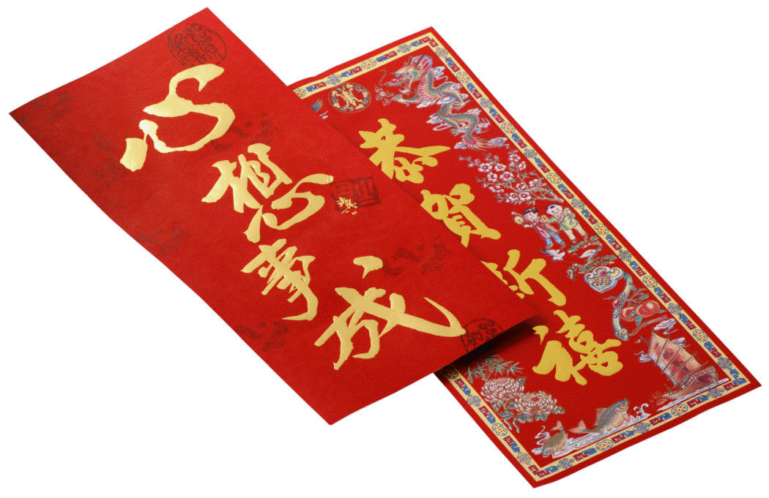
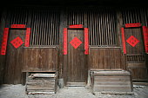
Lunar New Year Tradition
Red Envelope
Adults or parents give Red envelopes (with money inside) to children during Lunar New Year celebration.
Upside Down “Fu”
The most popular Lunar New Year crafts are the upside down character of "Fu". "Fu" in Chinese means luck, happiness, and prosperity. The upside down means coming. This craft means luck, happiness, and prosperity is coming.
Chun Lian - Couplets
It is a pair of lines of poetry with uplifting meanings (usually hand written) on red paper and pasted on each side of a door.

