Slide 1
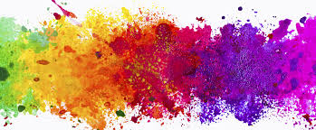
Top 11 Colors
By: Lainey, Caitlin, and Charlotte

Slide 2
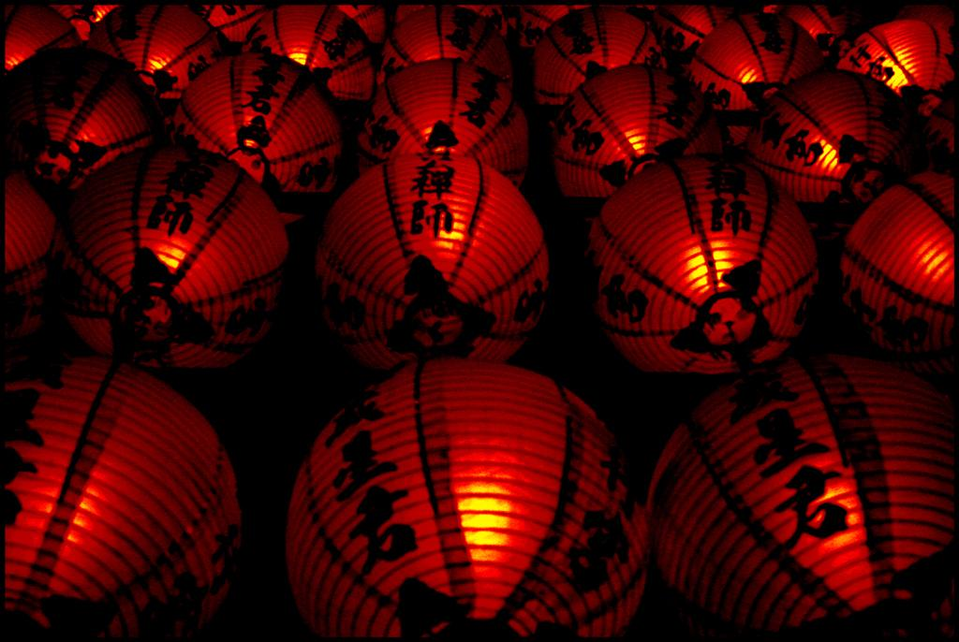
Red
hóng sè
红色
On a Mask:
Indicates a positive character
Prosperity, Loyalty, Courage Heroism, Intelligence And Bravery.

Slide 3
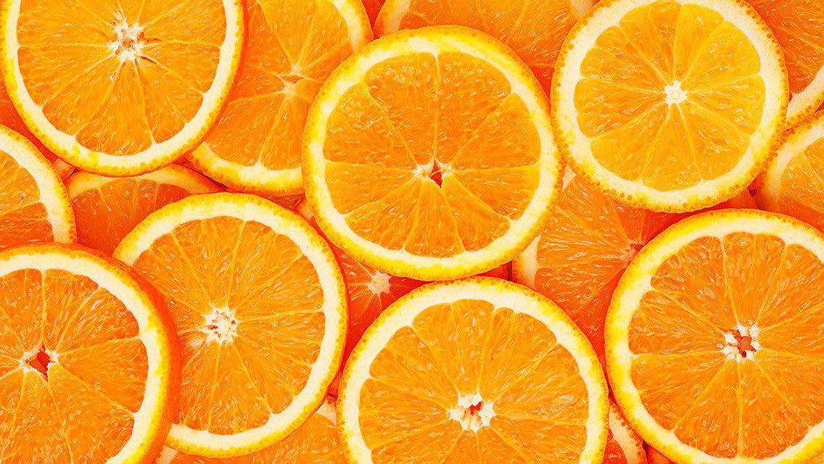
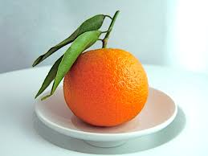
Orange
chéng sè
橙色

Slide 4
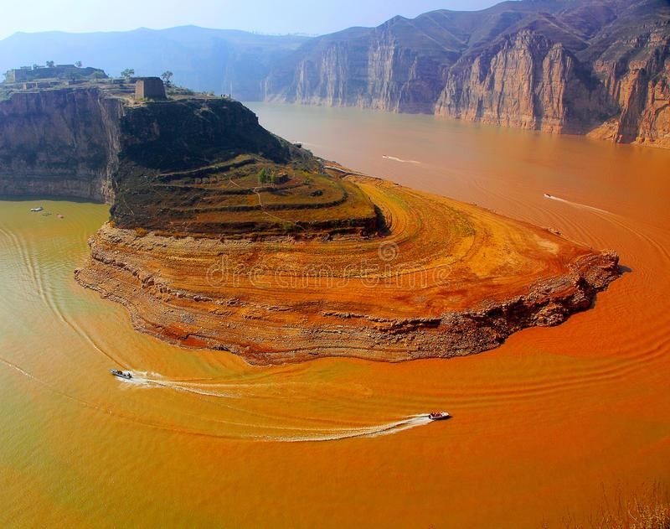
Yellow
huáng sè
黄色
On a Mask:
Cruel, Evil, Sly, Hypocritical

Slide 5
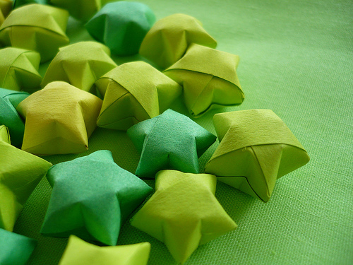
Green
lǜ sè
绿色
On a Mask:
Impulsive, Violent, and
Lacks Restraint

Slide 6
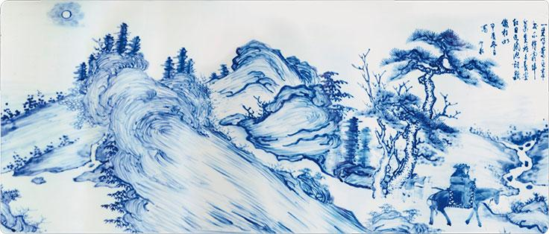
Blue
lán sè
蓝色
On a Mask:
Bravery, Neutrality, Stubbornness, and Fierceness

Slide 7
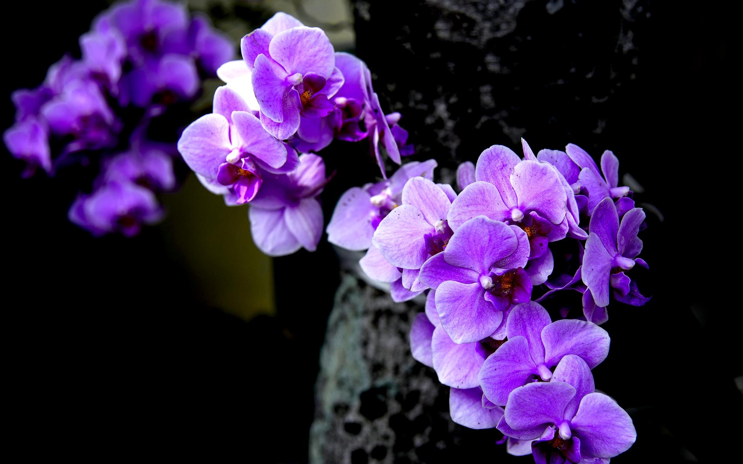
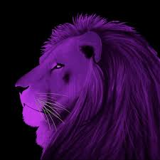
Purple
zǐ sè
紫色
On a Mask:
Justice and Sophistication

Slide 8
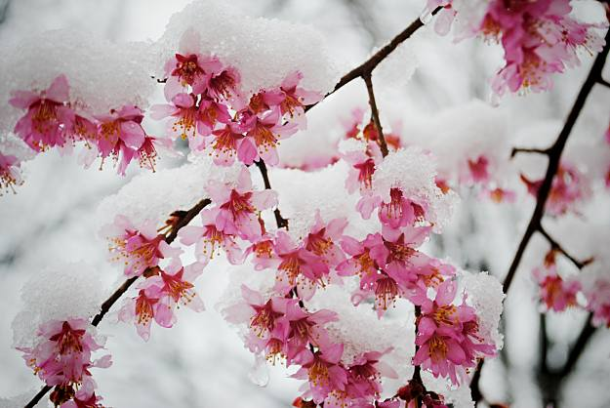
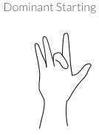
Pink
fěn hóng sè
粉红色
Pink is seen as a shade of red,
and therefore is a good color

Slide 9
Black
hēi sè
黑色
On a Mask: Neutrality,
Impartiality and Integrity

Slide 10
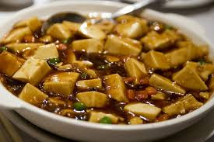
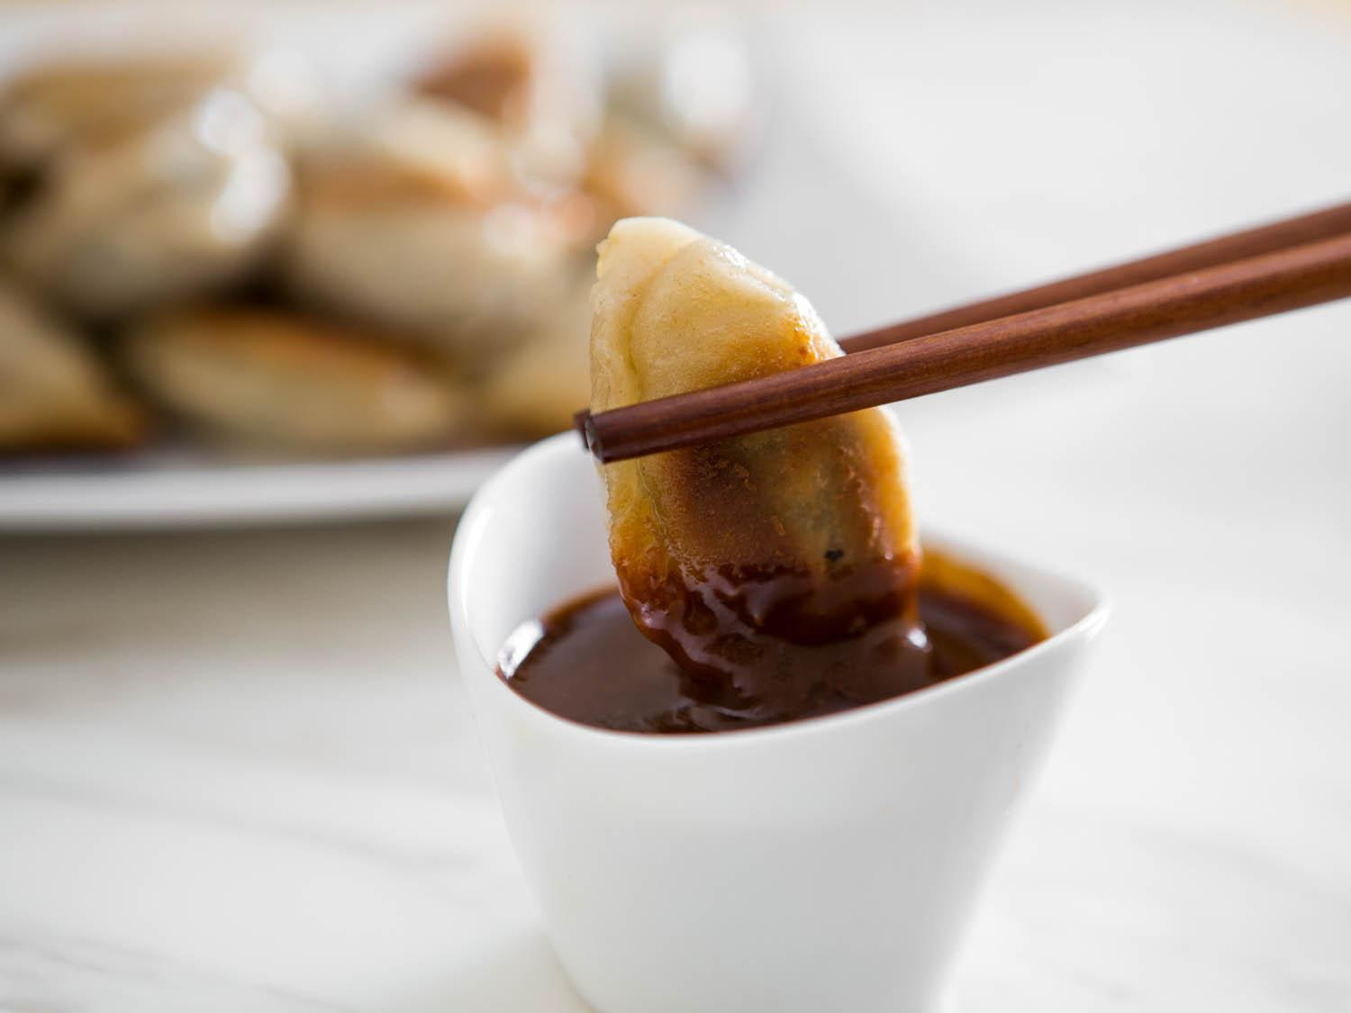
Brown
zōng sè
棕色

Slide 11
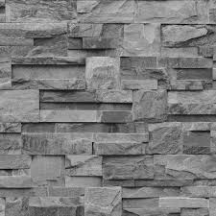
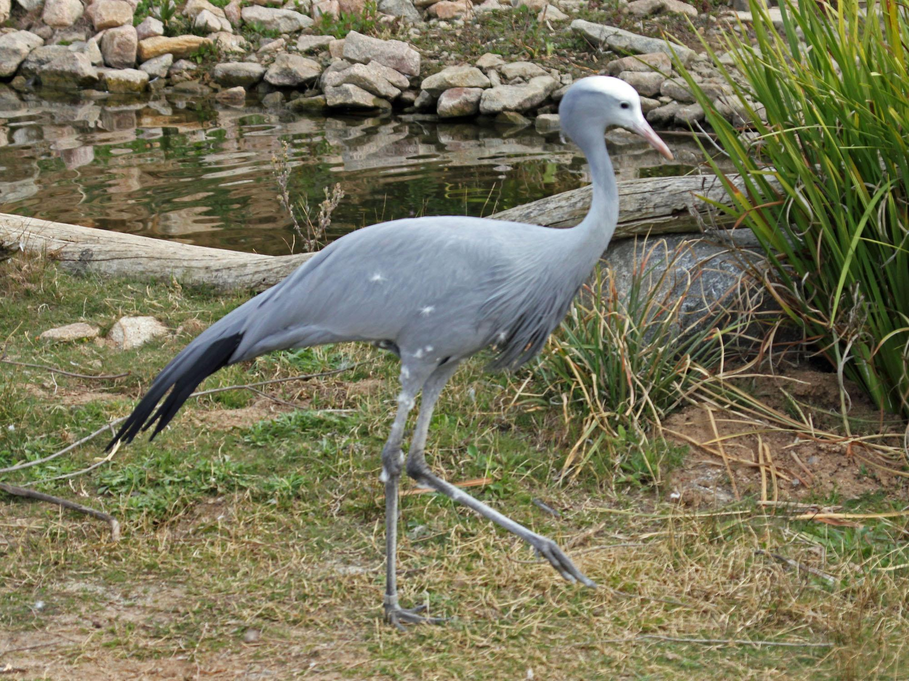
Grey
húi sè
灰色

Slide 12
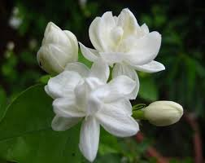
White
bái sè
白色
On a Mask: Evil and Hypocritical

Slide 13
Review Time!
Video on Colors
Another Color Video
Hand Gestures
Color Review Quizlet
IChinese Reader Book
KAHOOT!!!!

Slide 14
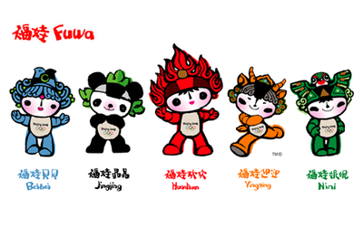
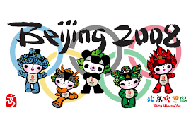
Olympic Mascots
Beibei
Jingjing
Huanhuan
Yingying
Nini
“Welcome to Beijing” (Bei Jing Huan Ying Nin)
Each color and mascot represents a ring
Also each one represents a wish (traditional culture)
Correspond to the five natural elements
Besides Huanhuan(fire) they are the four most popular animals in China

Slide 15
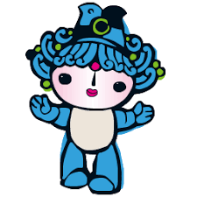
Beibei
Fish → element of water
blue = wish is prosperity
The waves on her head are based on a design in traditional Chinese painting
lán sè
蓝色

Slide 16
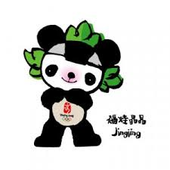
Jingjing
panda → forest
black = wish is happiness
Porcelain paintings from the Song dynasty were the inspiration for the lotus flowers on his head
hēi sè
黑色

Slide 17
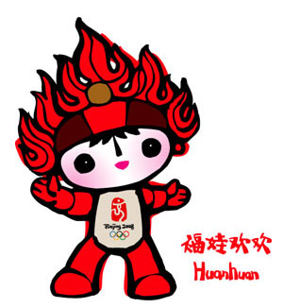
Huanhuan
fire = Olympic spirit
red =passion of sport
Dunhunag grotto art inspired the decoration on his head, together with certain traditional good-luck designs.
hóng sè
红色

Slide 18
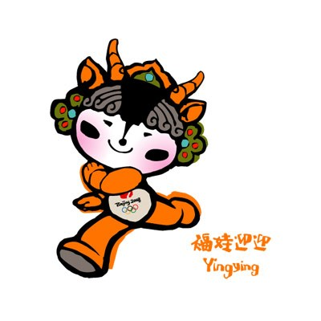
Yingying
Tibetan antelope= earth
yellow = his wish is good health
Decorative elements from Western China appear on his head
huáng sè
黄色

Slide 19
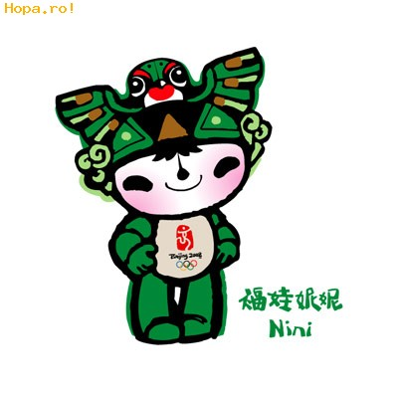
Nini
Swallow (bird)→ sky
green = her wish is good luck
Her design is inspired by Chinese kites
lǜ sè
绿色

Slide 20
Sources
http://www.nouahsark.com/en/infocenter/culture/art/opera_masks/meaning.php
https://www.olympic.org/beijing-2008-mascots

