Slide 1
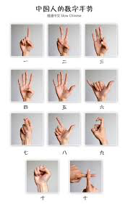
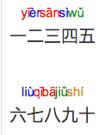
0

Slide 3
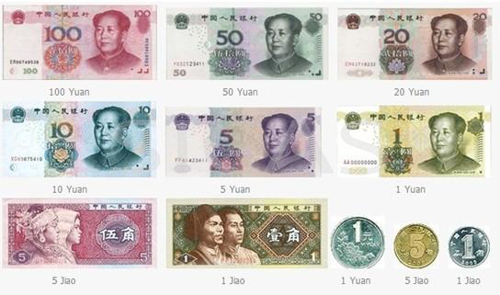

Slide 4
Notes:
https://world.tmall.com/item/538793934795.htm?id=538793934795&ali_refid=a3_430620_1006:1106735280:N:%E5%A5%B3%E8%A3%85:c0615067bcf07c2908c4ecf373491045&ali_trackid=1_c0615067bcf07c2908c4ecf373491045&spm=a312a.7700714.0.0.vMp2I7

Slide 5
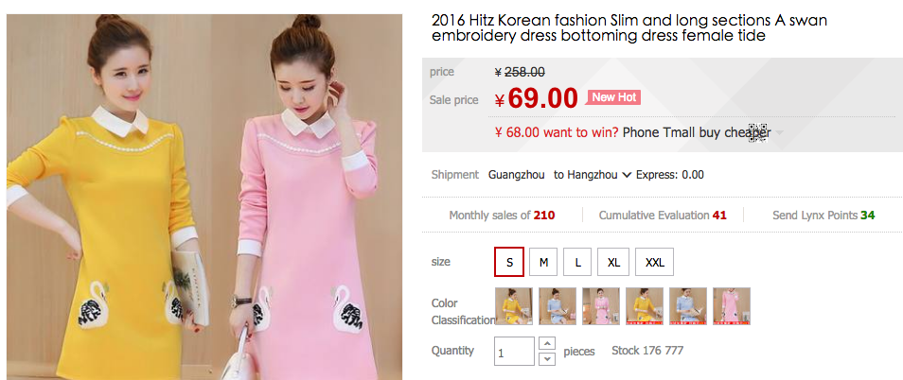

Slide 6
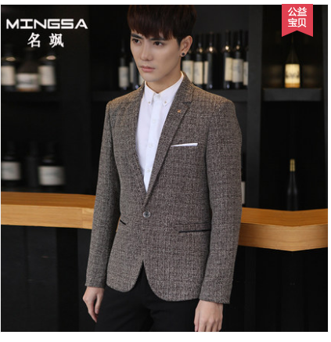

Slide 7
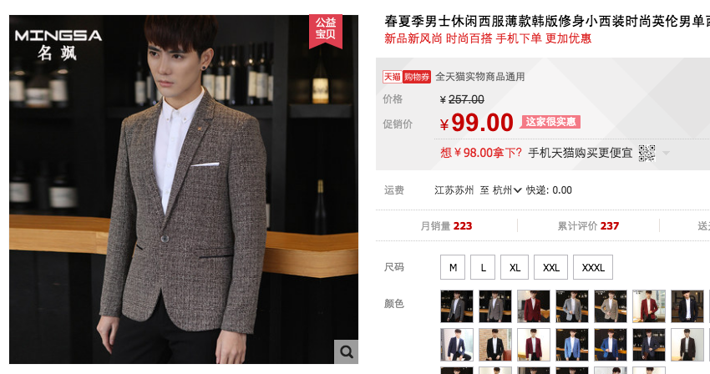

Slide 8
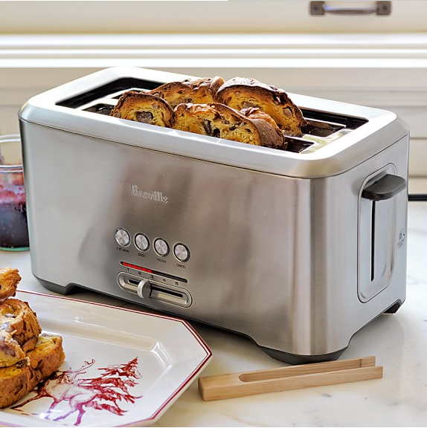

Slide 9
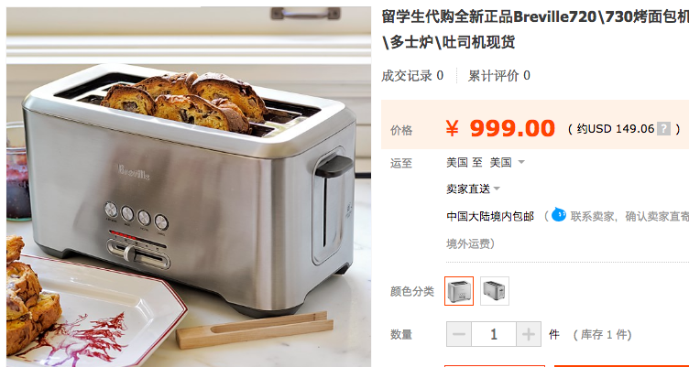

Slide 10
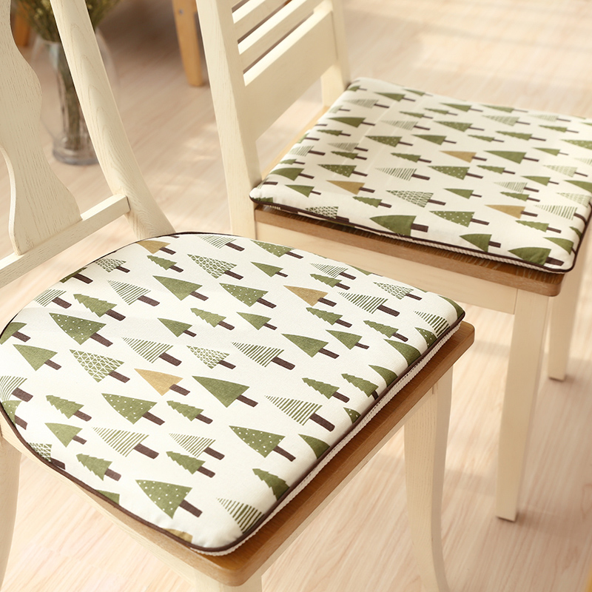

Slide 11
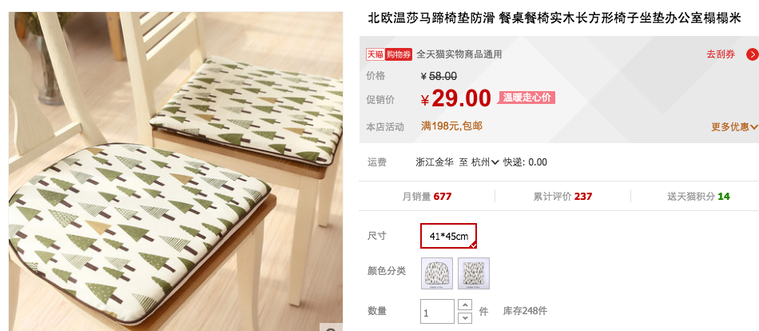

Slide 12
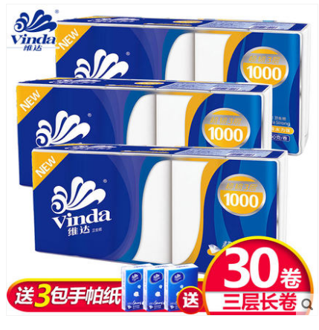

Slide 13
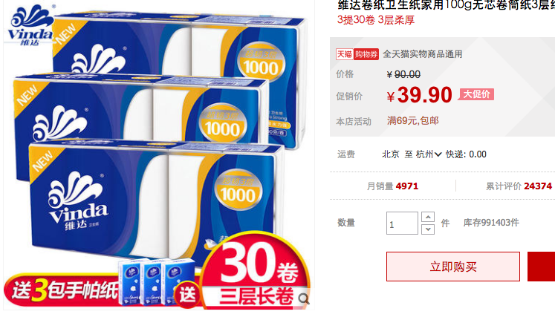

Slide 14
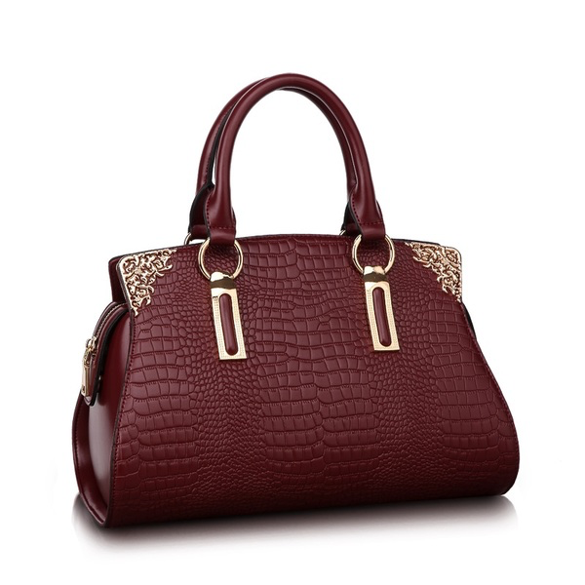

Slide 15
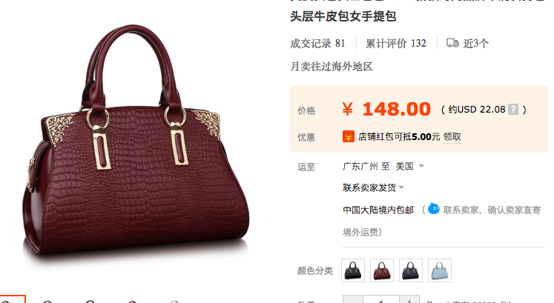

Slide 17
