Slide 1
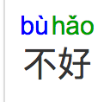

Slide 3
Notes:
http://www.archchinese.com/chinese_english_dictionary.html?find=%E4%B8%8D

Slide 6
