Slide 1
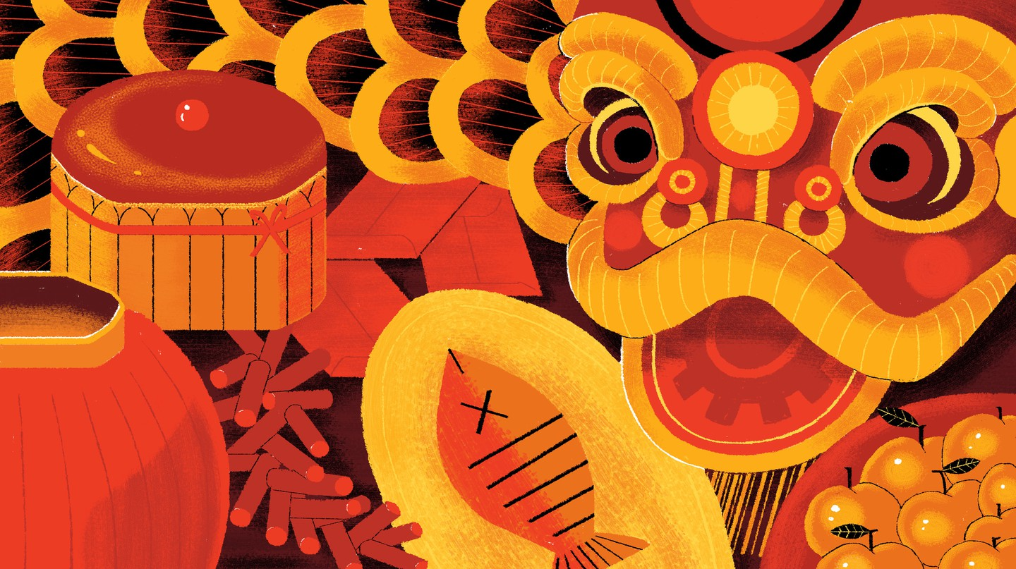
When and How to Celebrate Chinese New Year

Slide 2
Wait, are you still celebrating new year?
Notes:
All: Hi Everyone, we wish you a Happy New Year!
A: Wait, I think new year is over.
B: We are celebrating Chinese New Year.
A: What is Chinese New Year?
C: Chinese New Year is celebrated in China and many Asian countries, in China it is actually called the Spring Festival. Since it is based on the Lunar Calendar, it is also known as the Lunar New Year.
A: The what?
C: The Lunar New Year, Lunar means moon
A: Oh!.... I don’t get it
C: You know the calendar in our room listing January, February, March…, that calendar is called Gregorian calendar or Solar calendar, it is based on the orbit of the earth around the sun, in other words, one year in solar calendar is how long it takes the earth to go around the sun once.
D: The Chinese Lunar calendar, however, is based on the phases of moon, a new month begins when there is a new moon. Every 12 months we celebrate the Lunar New Year on the first day of the lunar new year.

Slide 3
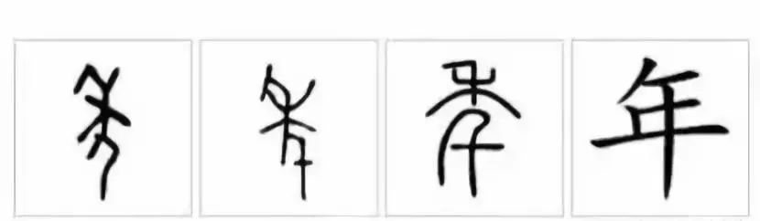
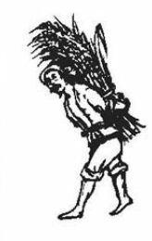
The Chinese Character of Year
Nián

Slide 4

A Youtube Video – The Legend of Chinese New Year

Slide 5
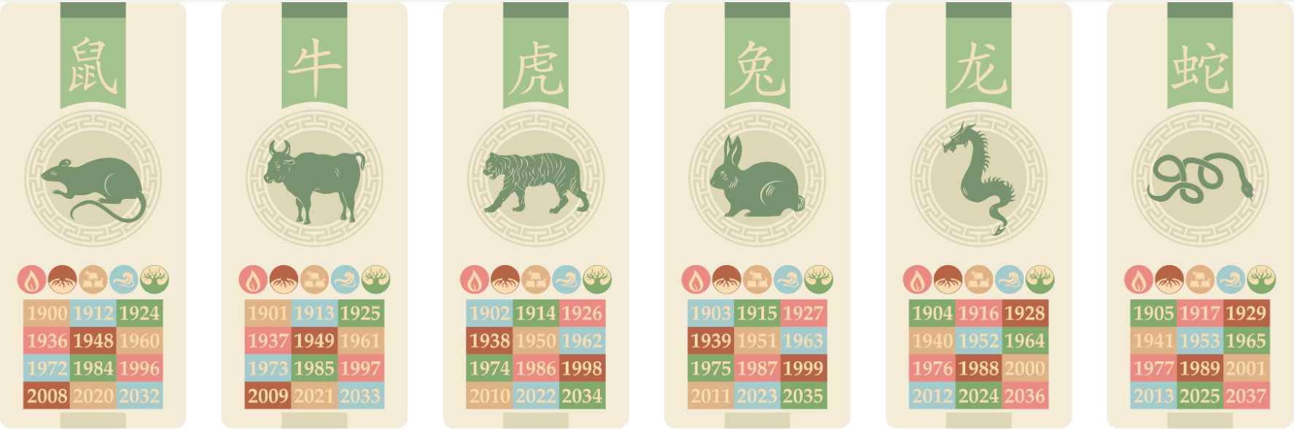
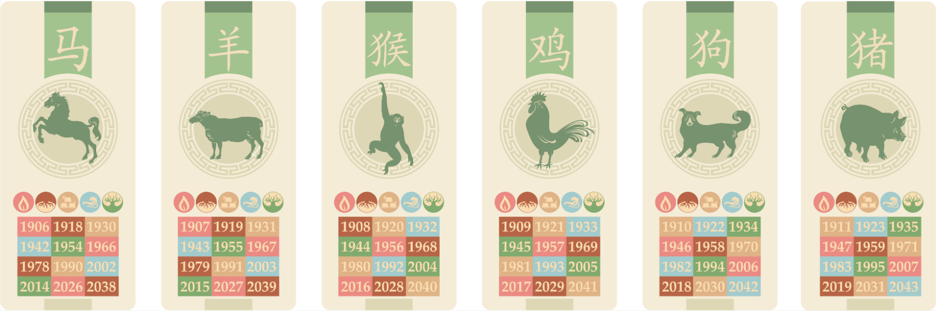
What is your Chinese Zodiac Animal?
Gold Rat
(1960, 2020)
Smart
Resourceful
Wealthy
Prosperous

Slide 6
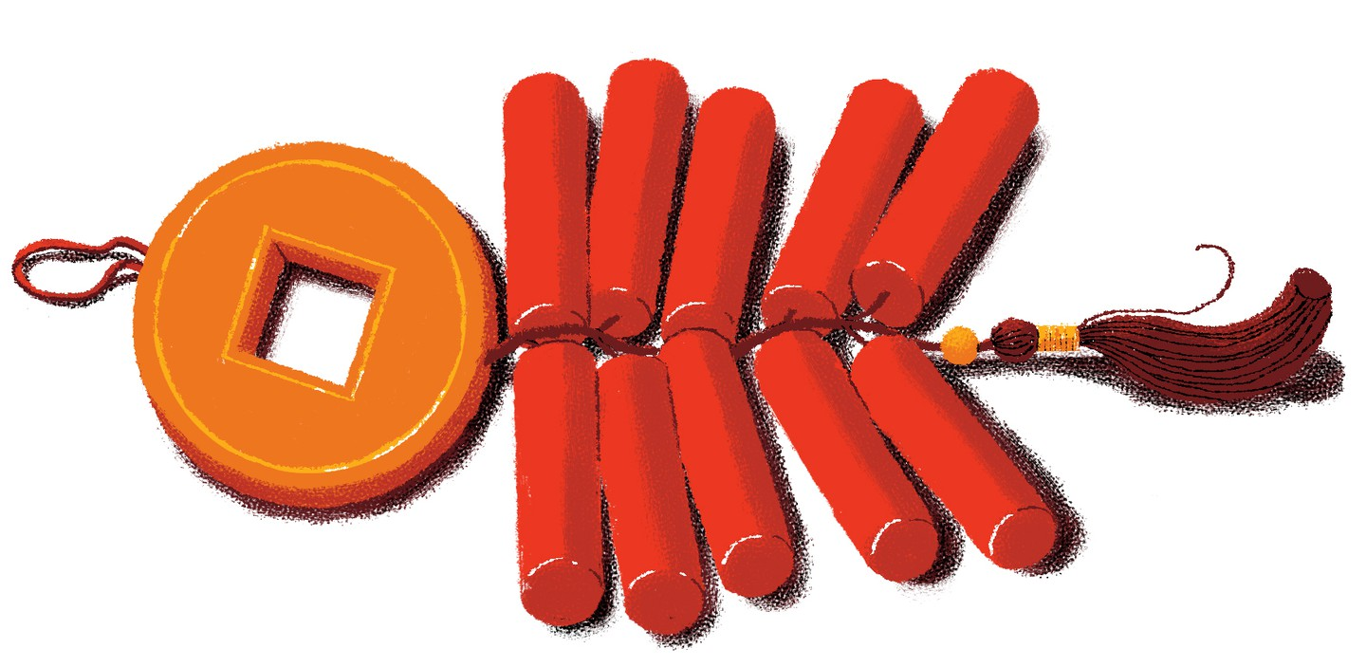
How to Celebrate Chinese New Year?
-Wear New Clothes and Clean Houses
Notes:
Narrative:
From head to toe, all clothes worn on New Year‘s Day should be brand new. Some families still wear traditional Chinese clothing.
During the celebration in China, the first day of the new year marks the end of the winter, so the cleaning ritual that happens before is also spring cleaning. When houses are clean, good luck will come in!

Slide 7
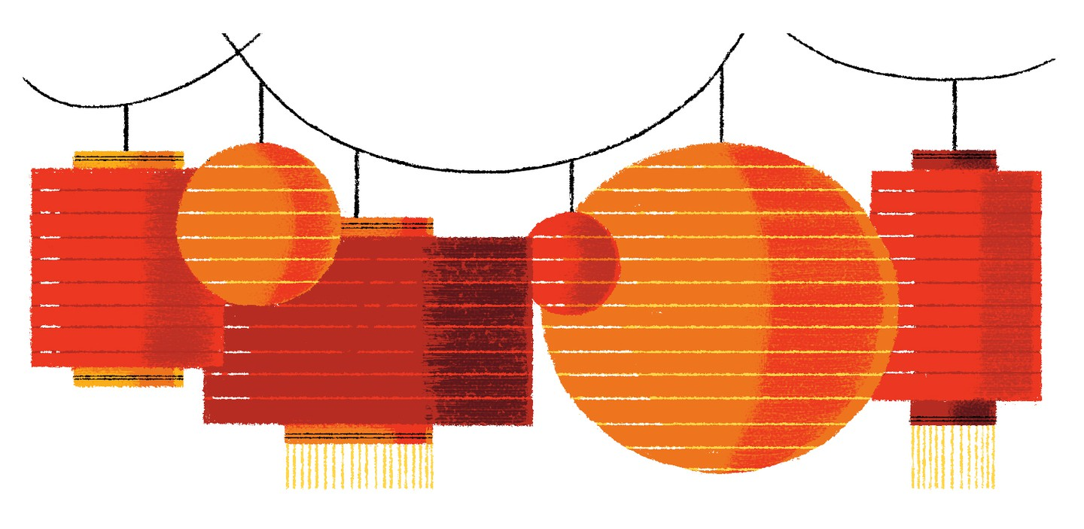
How to Celebrate Chinese New Year?
- Decorate the house
Notes:
Narrative:
It is tradition to hang Poem Couplets usually around the door, stick Paper Cutouts on window glasses, hang Red Lanterns. Red and Gold are lucky colors!

Slide 8
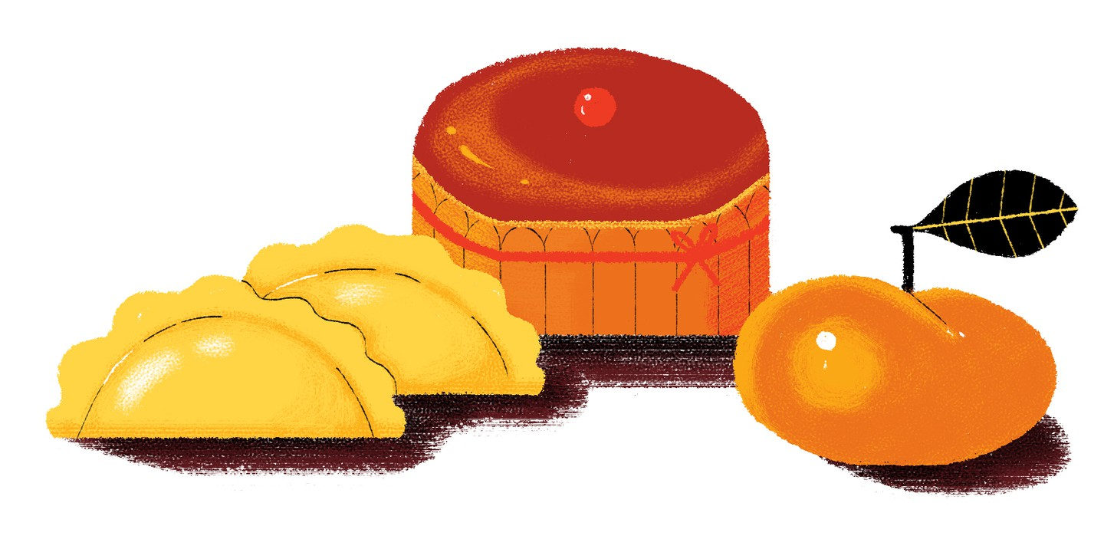
How to Celebrate Chinese New Year?
-Family Reunion Dinner
Notes:
Narrative:
Have Dinner with your Family on the new year’s eve. This is called the reunion dinner. You wants to have a lot of food. Having leftovers symbolizes the abundance of wealth coming your way to the new year. Also the dinner includes traditional good luck foods like fish, noodles and dumplings. Hmm, dumplings are my favorite

Slide 9
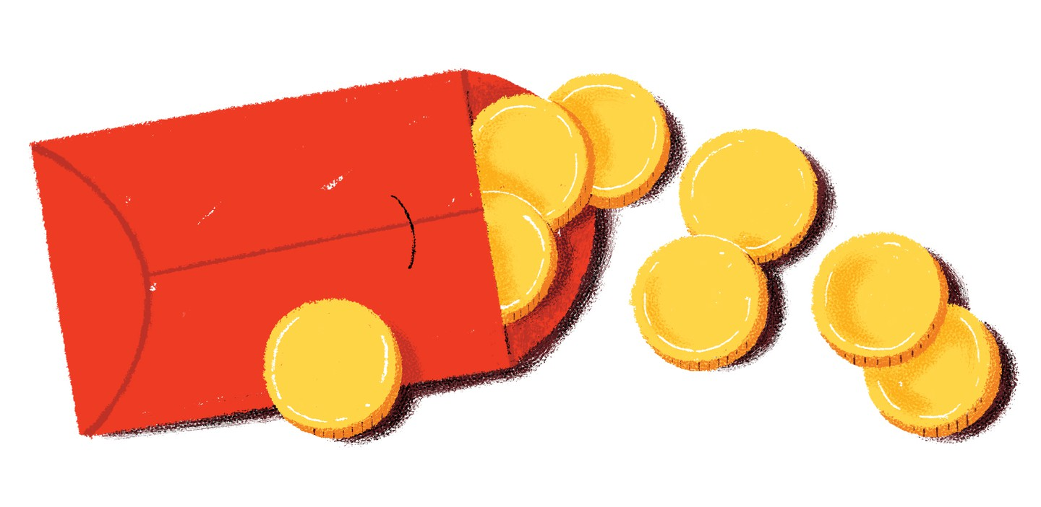
How to Celebrate Chinese New Year?
-Pass out Hong Bao
Notes:
Narratives:
It’s a tradition that older married couples give red envelops with money inside to younger single members of the family. The younger person says very special phrases back

Slide 10
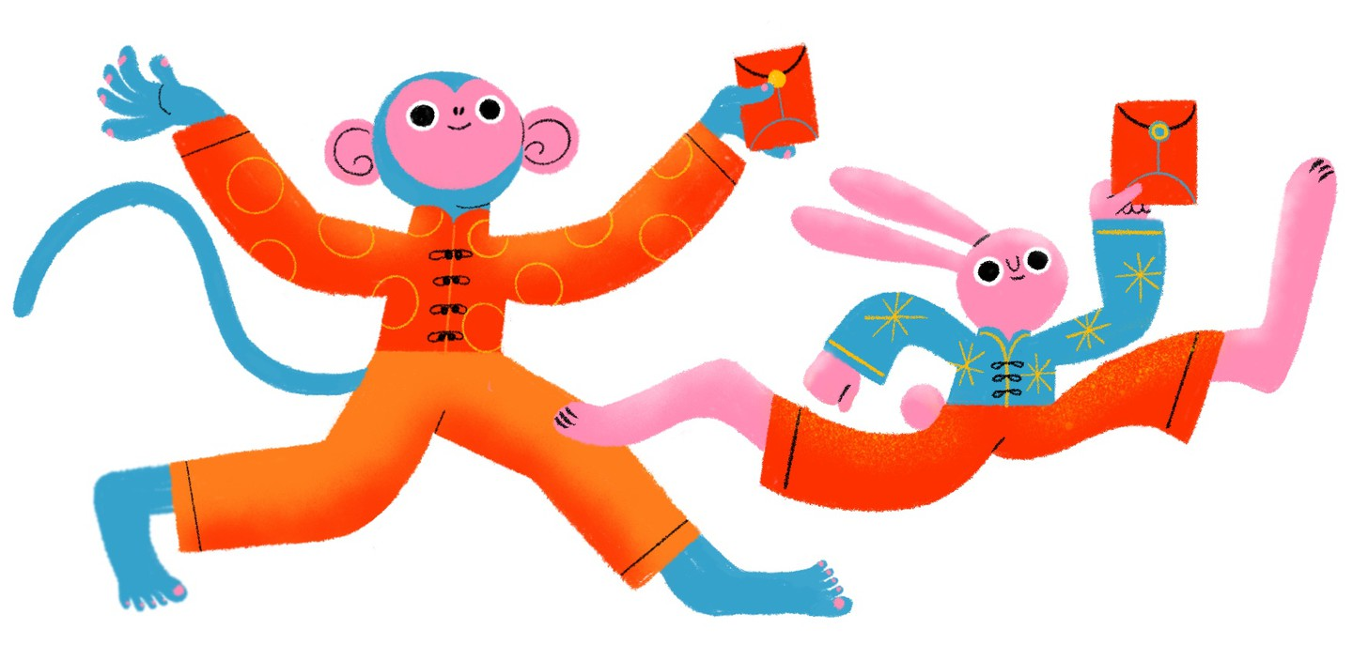
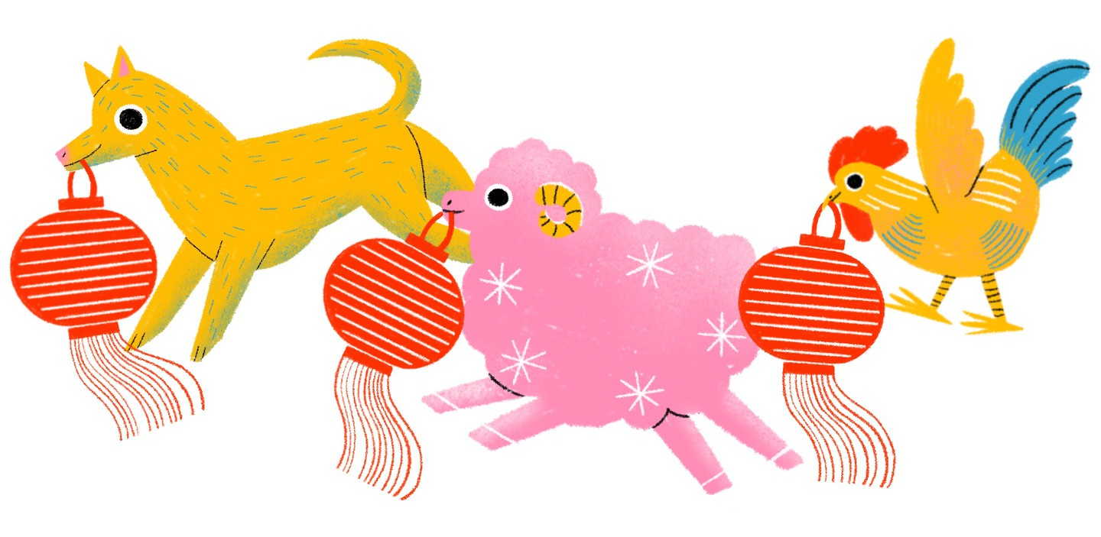
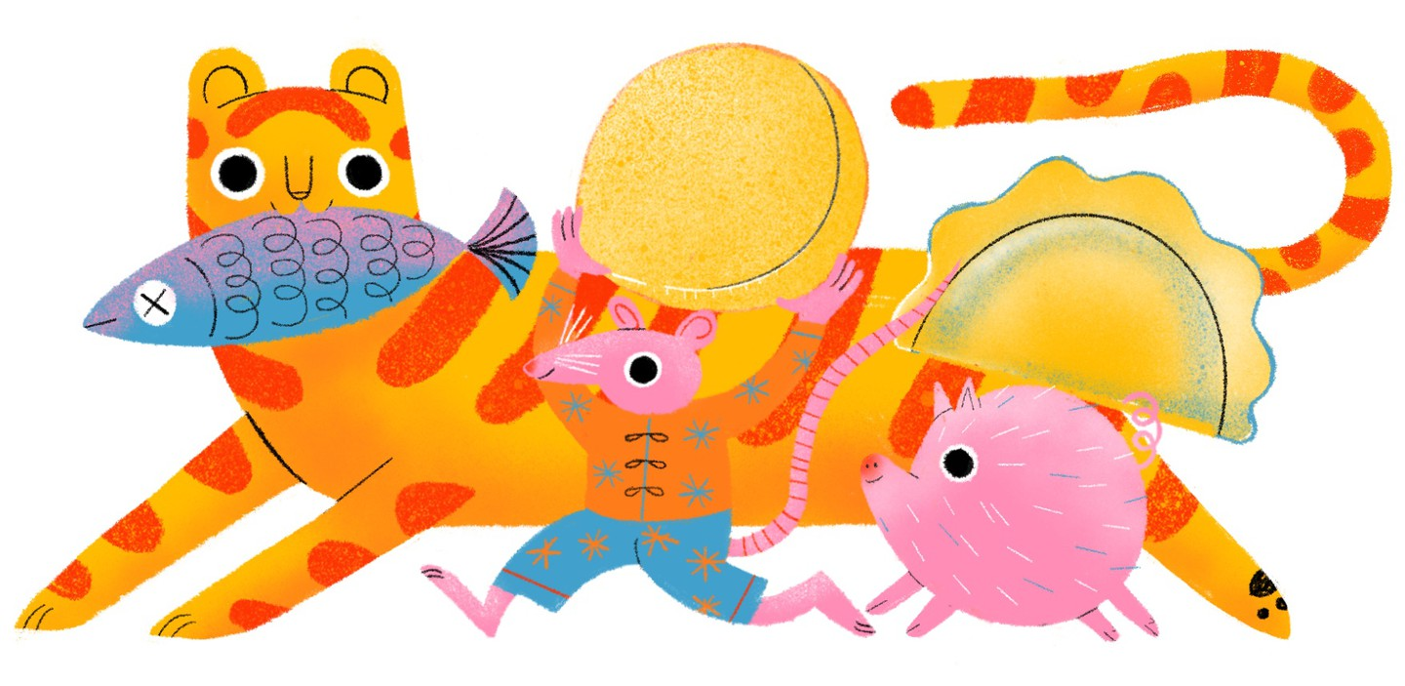
Let’s Say “Happy Chinese New Year”
新年快乐！
Xīn Nián Kuài Lè !

Slide 11
Play and Acts
What is Chinese New Year?
  Video - Wait, still celebrating Chinese new year? 5 min
  Chinese Character – 年(Nian) 2 min
  Youtube Video - Story about Chinese New Year 2 min
  What is your Chinese Zodiac Animal 3 min
How to celebrate Chinese New Year? – Something you can do outside China
  Video - Wear New Clothes and Clean Houses – 2 min
  Video - Decorate the house – 2 min
  Video - Family Reunion Dinner – 2 min
  Video - Pass out Hong Bao (Red Envelops) – 2 min
Let’s say “Happy Chinese New Year!” – 新年快乐！- 2 min

Slide 12
