Slide 2
Notes:
Sorry

Slide 3
Notes:
Chinese

Slide 4
Notes:
Chinese

Slide 5
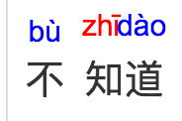
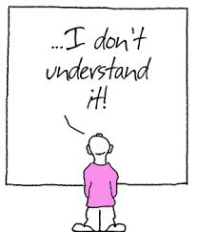
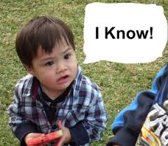
Notes:
Do not know

Slide 6
Notes:
speak

Slide 8
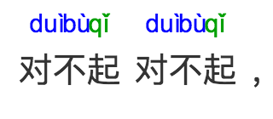
Notes:
Sorry my Chinese is not good. Sorry, sorry! I do not know what you are speaking.

Slide 9
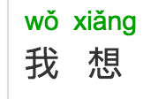
Notes:
I only want to

Slide 10
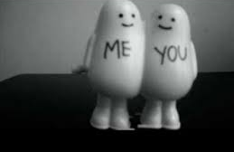
Notes:
With you

Slide 11
Notes:
Be friends

Slide 12
Notes:
Sorry my Chinese is not good. Sorry! Sorry! I just want to be friends with you.

Slide 21
Notes:
Hello, how are you? Your English sounds very good! Are you American? Not American. I am a British gentleman. If you listen carefully, you will understand me.

Slide 23
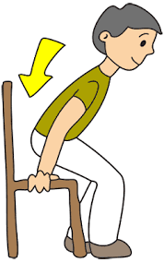

Slide 26
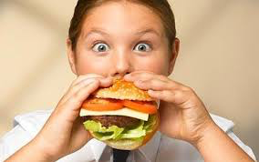

Slide 28
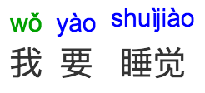
Notes:
Welcome! Come inside! Sir, what do you want to eat? I want to sleep.

Slide 29
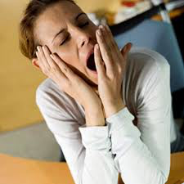

Slide 31
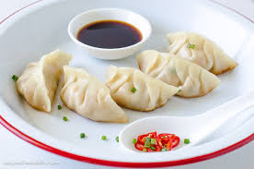

Slide 33
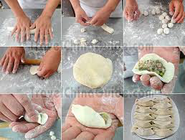

Slide 34
Notes:
Are you tired, yes or no? I am not tired. My tummy is very hungry. I want to eat dumplings. Please you hurry up make it.

Slide 35
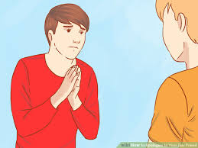

Slide 38
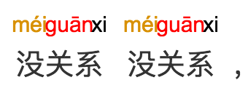
Notes:
It is ok. My Chinese is improving. It is ok. It is ok. I still want to be your friends.

