Slide 1
Top 10 Telecom Companies in the World
Notes:
https://www.youtube.com/watch?v=5zQjBLFL8zY

Slide 3
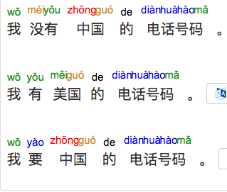

Slide 4
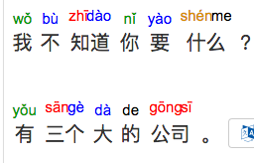
Notes:
https://www.youtube.com/watch?v=5zQjBLFL8zY

Slide 5
Notes:
https://www.youtube.com/watch?v=5zQjBLFL8zY

