Slide 1
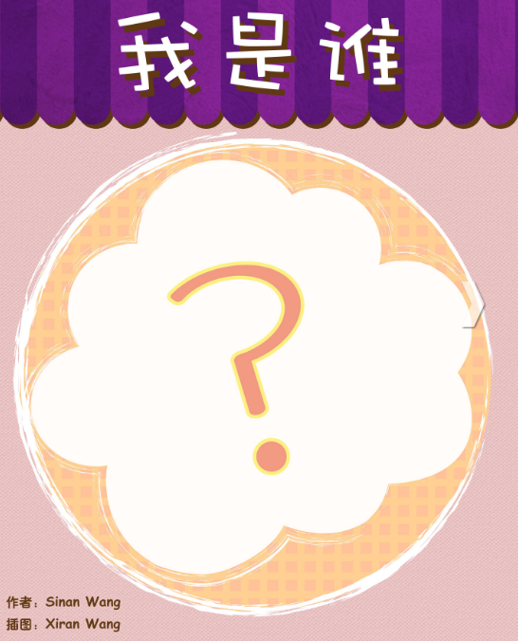

Slide 2
Notes:
猜猜- cāi cai, guess

Slide 3
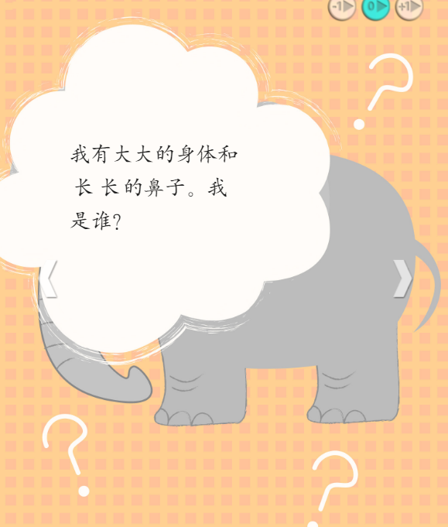

Slide 4
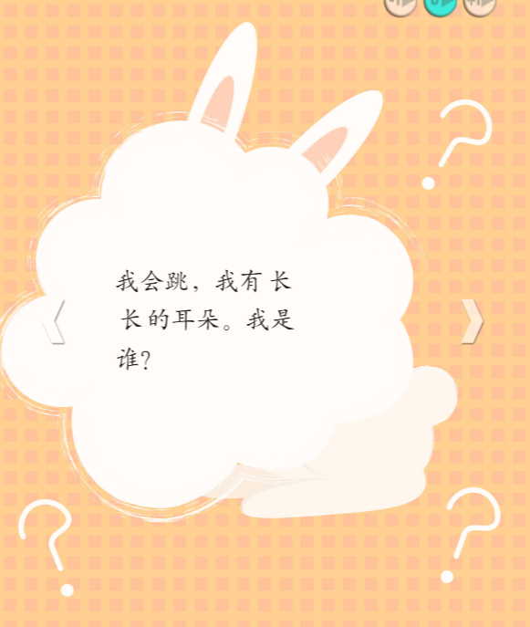
Notes:
跳 tiào; jump, hop

Slide 5
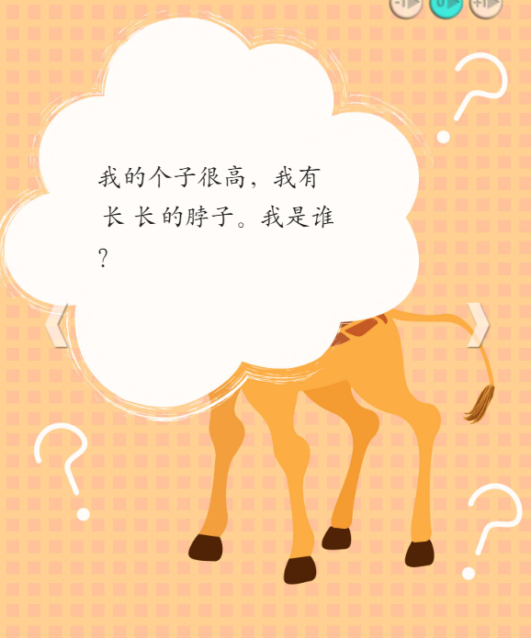
Notes:
脖子—bó zi; neck

Slide 6
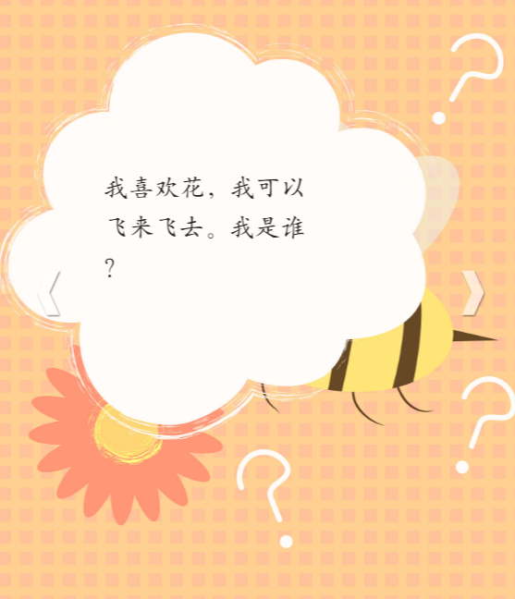
Notes:
花---huā ; flower, 飞来飞去----fēi lái fēi qù; fly around

Slide 7
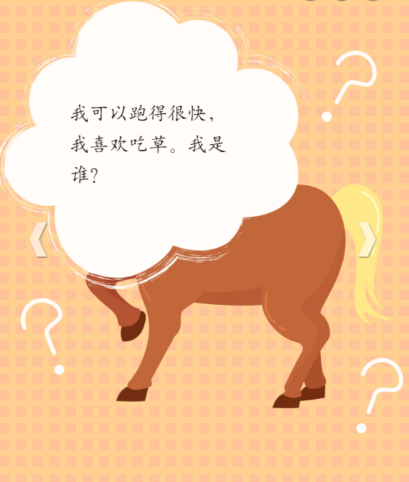
Notes:
得： de 草 ：cǎo; grass

Slide 9
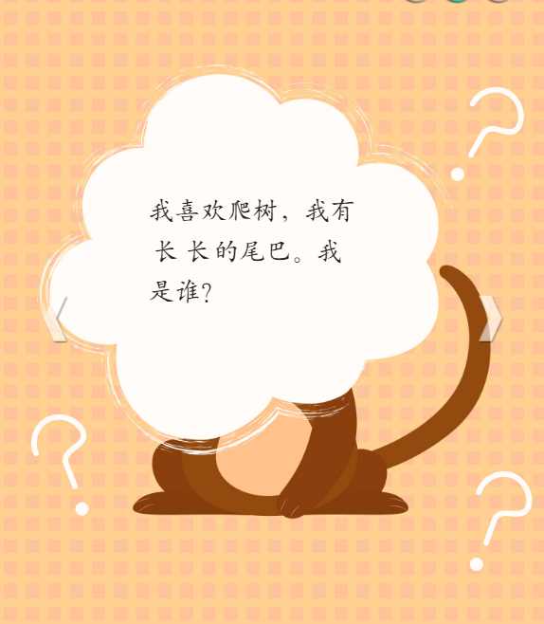
Notes:
爬树： pá shù; climb tree

Slide 10
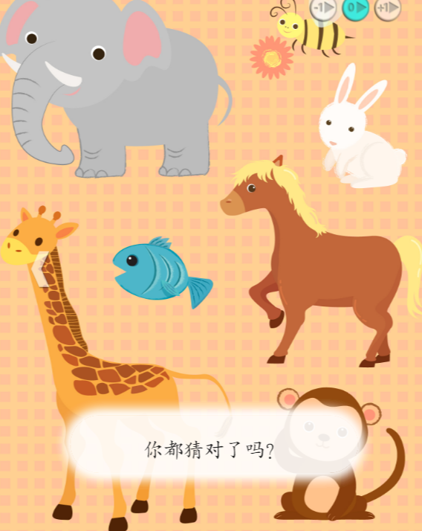
Notes:
猜： cāi; guess

